Slide 1
Classification with Logistics Regression
Week 4

Slide 2
What’s Classification?
In machine learning, pattern recognition is the assignment of some sort of output value (or label) to a given input value (or instance), according to some specific algorithm.
Classification is the problem of identifying to which of a set of categories a new observation belongs, on the basis of a training set of data containing observations whose category membership is known.
Both Regression and Classification are aimed to find a function h which maps data X to feature y. In regression, y is a continuous variable.
In classification, y is a discrete variable (categorical variable).
In linear regression, data is modeled using a linear function, and unknown parameters are estimated from the data.

Slide 3
What’s Logistic Regression?
In statistics, logistic regression (sometimes called the logistic model or logit model) is used for prediction of the probability of occurrence of an event by fitting data to a logit function logistic curve. (Walker, SH and Duncan, DB ,1967)
It’s a form of regression that allows the prediction of discrete variables by a mix of continuous and discrete predictors.
Addresses the same questions that discriminant function analysis and multiple regression do but with no distributional assumptions on the predictors (the predictors do not have to be normally distributed, linearly related or have equal variance in each group)
Binary logistic regression is a type of regression analysis where the dependent variable is a dummy variable: coded 1-survived and 0 did not survive.

Slide 4
What’s Logistic Regression?
Assumptions
The only “real” limitation on logistic regression is that the outcome must be discrete.
Absence of multicollinearity
The presence of multicollinearity will not lead to biased coefficients.
But the standard errors of the coefficients will be inflated.
No outliers
Independence of errors.
Only the meaningful variables should be included.
Logistic regression requires quite large sample sizes.

Slide 5
What’s Logistic Regression?
In a strict sense, logistic regression is a probabilistic model
We can define a function
This is a valid conditional density function since the two components (f1f1 and f2f2, shown just below) sum to 1 and remain in [0, 1].
It looks similar to a step function, but we have relaxed it so that we have a smooth curve, and can therefore take the derivative.

Slide 6
What’s Logistic Regression?
Since the model is probabilistic.
This means that the output has to be able to provide us with probabilistic output
The output has to be between 0 and 1.
This allows to have two possible of outputs
Categorical or binary
Threshold based output. If the probability is > 0.5 then the output is 1
If the probability is <0.5, then the output is 0
Probabilistic output. The outcome is produced in a shape of probabilities of it either being 0 or 1

Slide 7
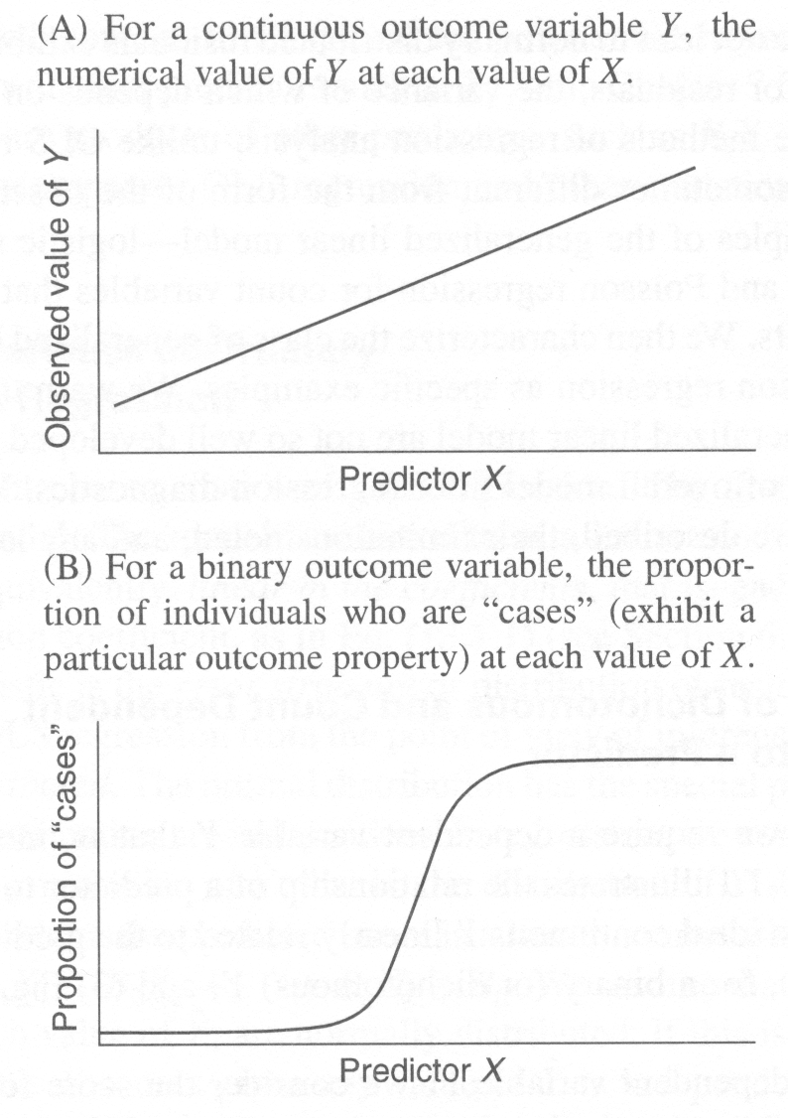
What’s Logistic Regression?

Slide 8
What’s Logistic Regression?
For example:
In our titanic data set the target is either Survived or Not survived
1 means survived
0 mean not survived
This result is definitive.

Slide 9
What’s Logistic Regression?
However, there is a need for variation
Hence, the probabilistic outcome
As a matter of fact, the previous outcome was a result of thresholding.
Some of the passengers had a probability of 1 of surviving, and almost no passenger was guaranteed to NOT survive.

Slide 10
How is it done?
Similar to the linear regression, you need
1- Import your data set
2- Know your predictors and target!, that is X,y
3- Choose your set of features
4- Divide the data into training and testing sets with their labels 5- Clean your data
6- Import Logistic regression
from sklearn.linear_model import LogisticRegression
lr = LogisticRegression(penalty = 'l1', C = 10,random_state = 1) 7- fit (train) your model
8- predict your target
9- Compare you target with your prediction
from sklearn.metrics import accuracy_score
accuracy_score(y_test,y_ predict), you need to import accuracy_score

